Slide 1

Basic Electrical and Electronics Engineering
Mr. K. Sateesh Kumar
Assistant Professor
Electrical and Electronics Engineering
SRMIST, Kattankulathur-60320

Slide 3

Contents of the Course:
Basic Circuit Analysis
Electrical Machines
House wiring
Transducer
Digital Electronics
BEE

Slide 4
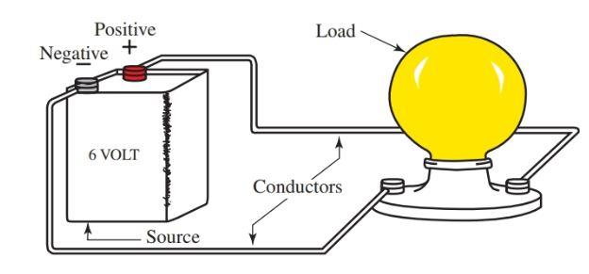
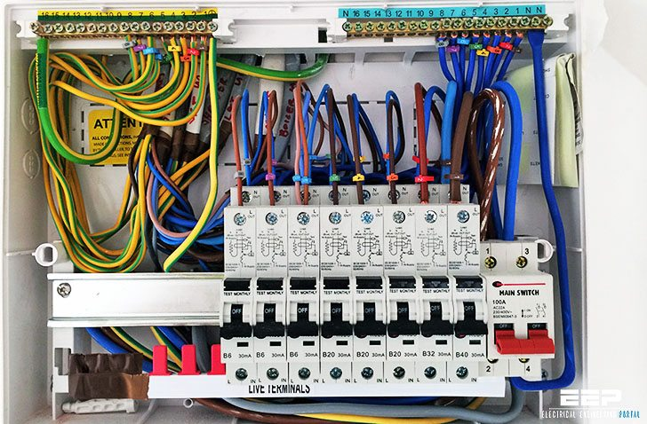
Electrical Circuits
Sub - Contents
Basic definitions
Electrical elements
DC and AC circuits
Transformations
Laws, Theorems

Slide 5
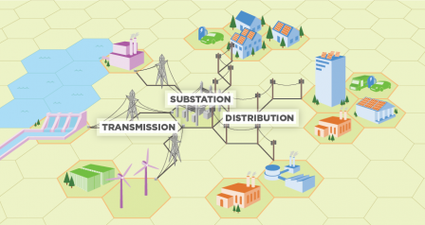
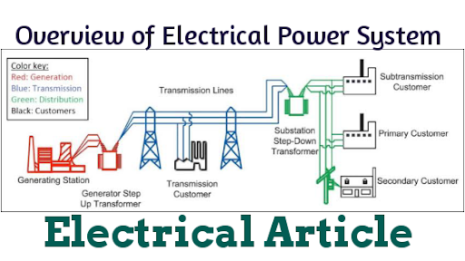
Power System Network

Slide 6


Slide 7
Goals and Objectives
Definitions of electrical quantities and their units
Understanding the relationship between charge, voltage, current, power and energy
Acquiring capability to work with sign convention
Ohm’s laws, Resistor, Inductor and Capacitor
Kirchhoff’s current law (KCL), Kirchhoff’s voltage law (KVL)
Basic problem solving on DC and AC circuits
Thevenin’s, Norton’s, Super position, Maximum power transfer theorems
AC circuit analysis and different types of powers
Magnetic circuits

Slide 8
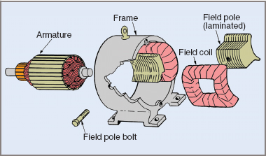
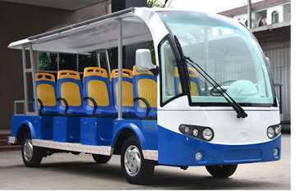
DC machines and AC machines
Sub - Contents
Faraday’s laws of electro-magnetic induction
DC motor
DC Generator
Single-phase transformer
AC motors
DC motor parts
Electric bus

Slide 9
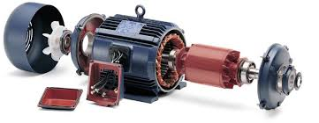
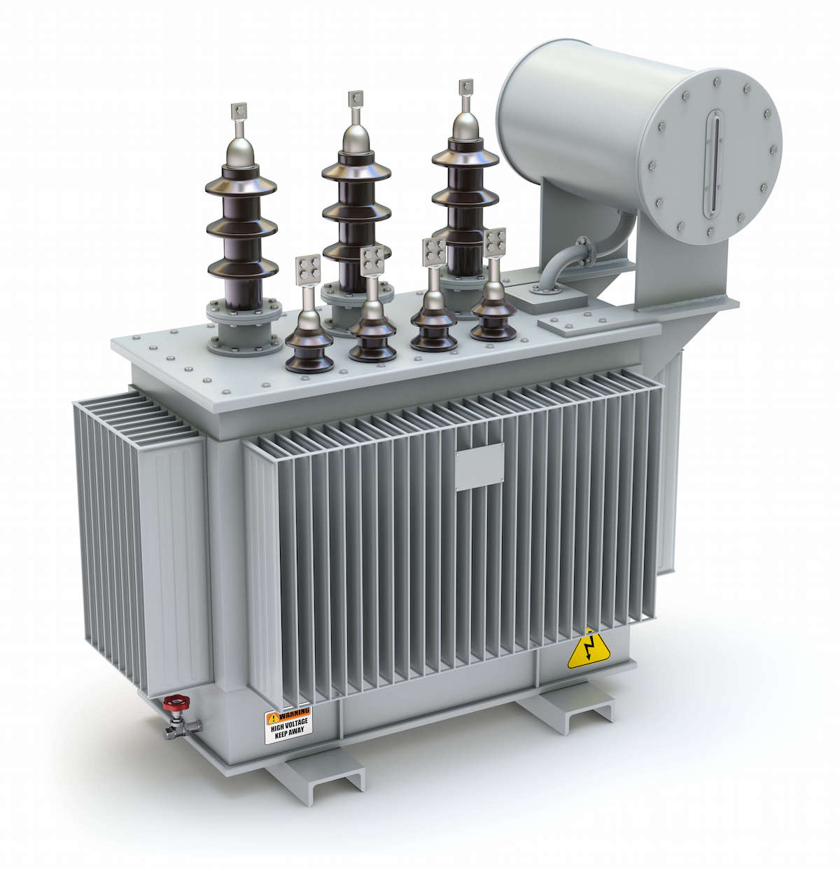
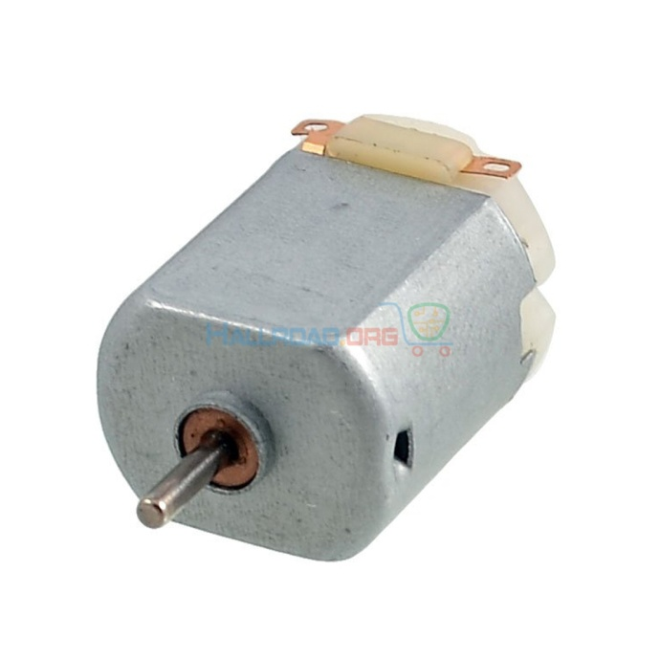
Electrical motor
DC motor used in toys
Transformer

Slide 10
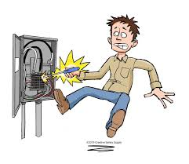
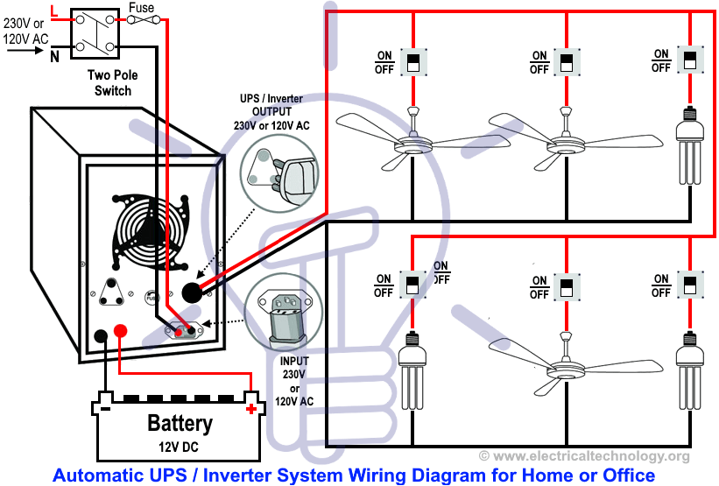
Electrical Safety, House wiring and
Measuring Instruments
Types of wiring and examples, principles of earthling, grounding,
Typical electrical wiring

Slide 11
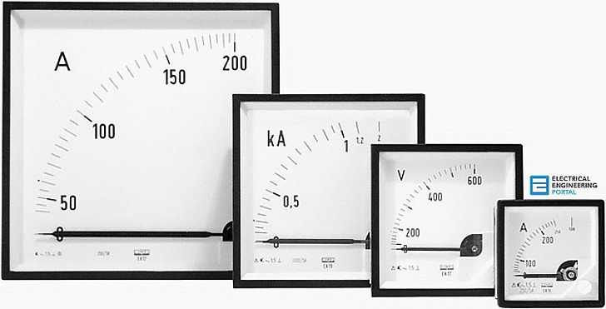
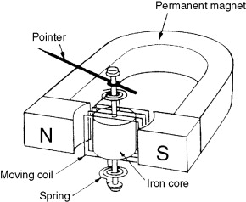
Measuring Instruments
Permanent magnet moving coil (PMMC)
Permanent magnet moving iron (PMMI)
Measurement of voltage
and current

Slide 12
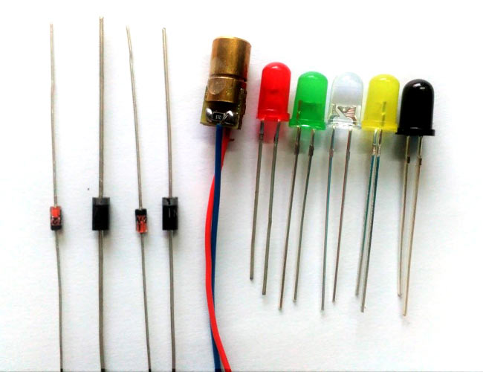
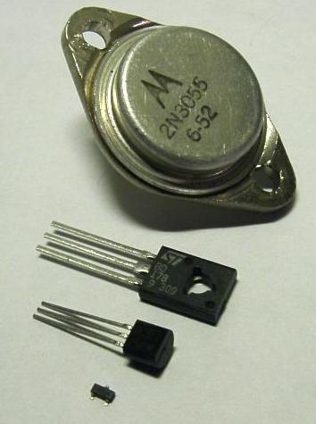
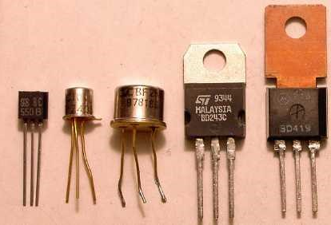
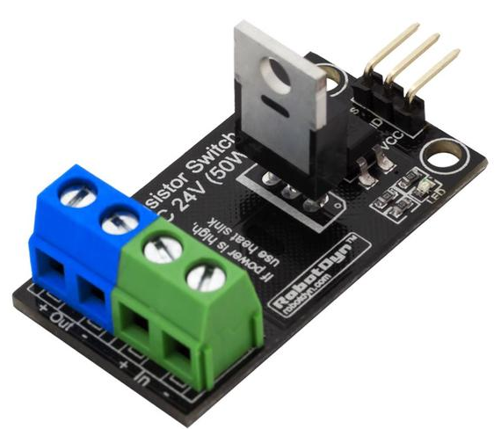
Semiconductor devices and characteristics
1 .PN Diode
2. Zener diode
3. BJT
4. JFET
5. MOSFET

Slide 13

Transducers
Active, Passive, displacement, LVDT, Strain gauge, Pressure, Laser, Photovoltaic, LED, Opto couplers

Slide 14
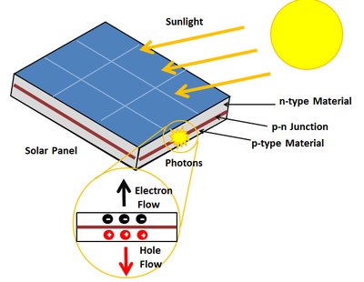
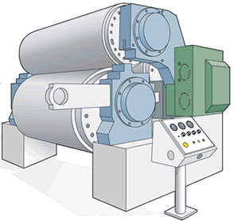
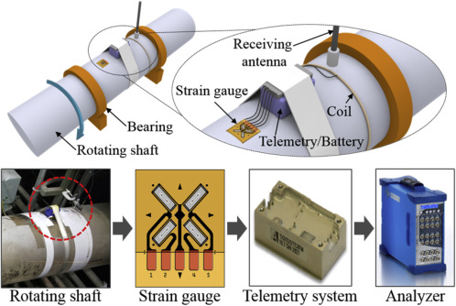
Solar Photovoltaic
Typical application to LVDT
Typical application to strain gauge

Slide 15
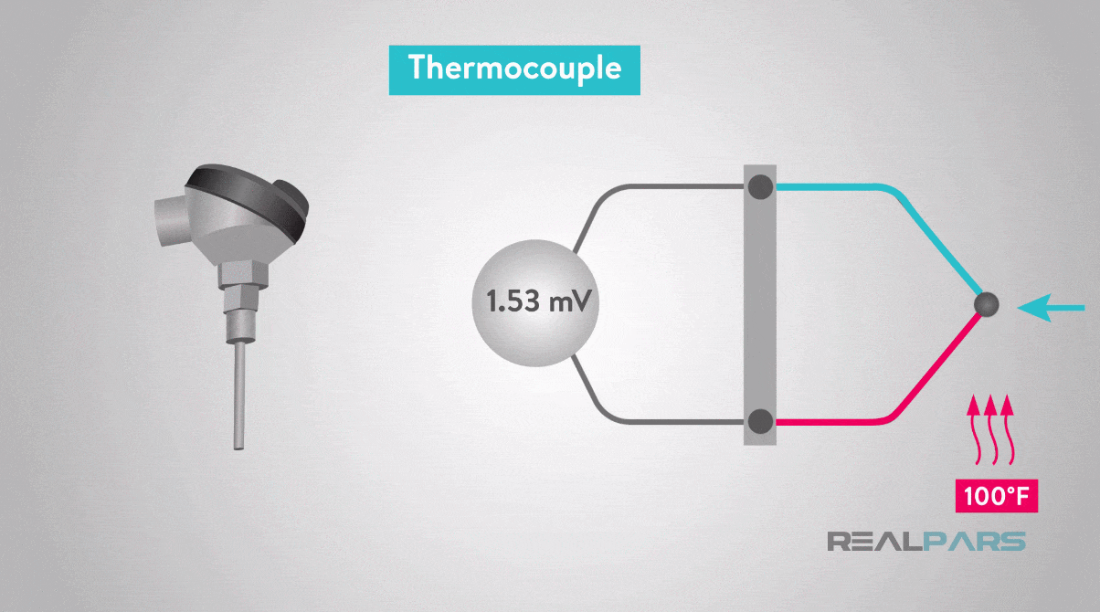
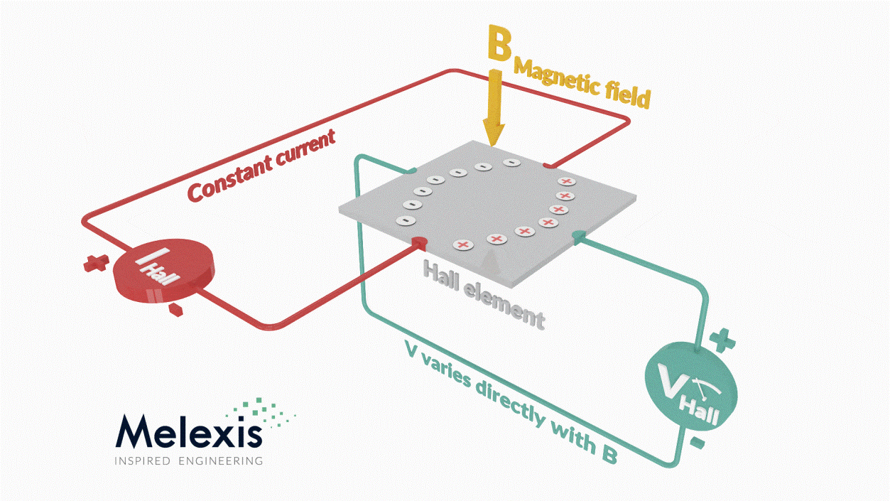
Thermo couple
Hall effect

Slide 16

Digital Systems
Boolean algebra, arithmetic, logic gates, K-map

Slide 17


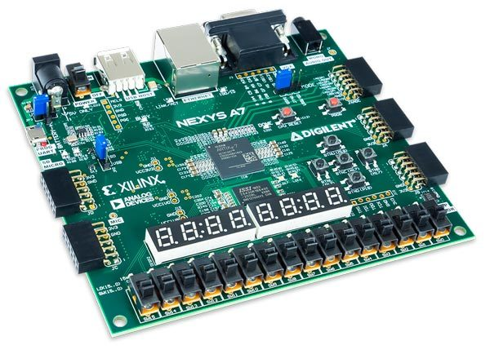
Digital controllers and processors

Slide 18
Tutorial - 01
Charge, Current, Voltage, Energy, Sources and Applications, Ohm’s Law, Resistor, Inductor, Capacitor , KVL and KCL

Slide 19
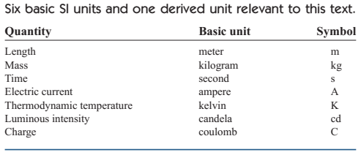
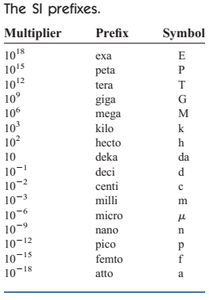

Slide 20
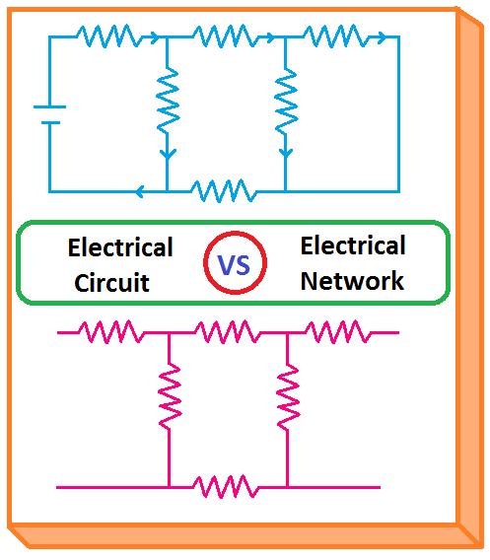
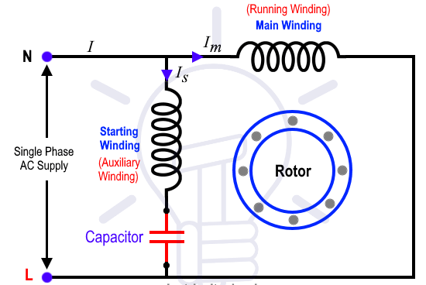
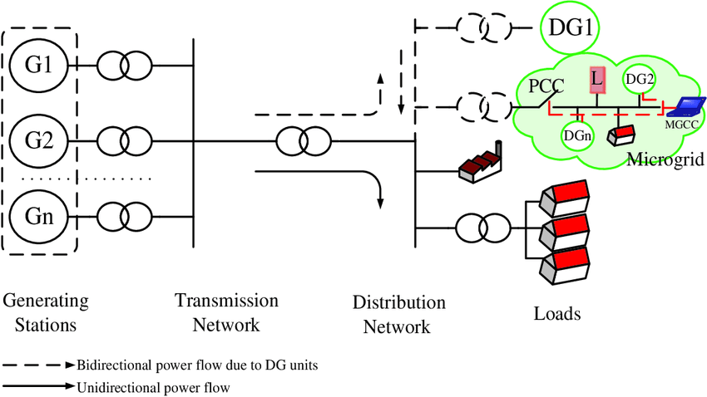
Def: Electrical circuit or Electrical network : Inter connection of Electrical elements
Electrical circuit: Current is intended to flow in
every element.
Electrical Network: Current does not necessary to
flow through all the elements.
Note: Every circuit is a network but not all the
networks are circuits
Ceiling Fan (single-phase Induction motor)
Modern power system network

Slide 21
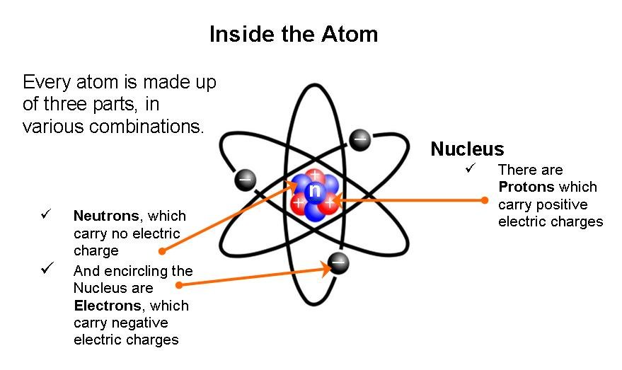
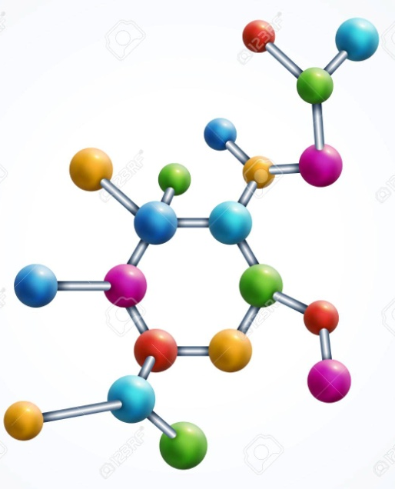
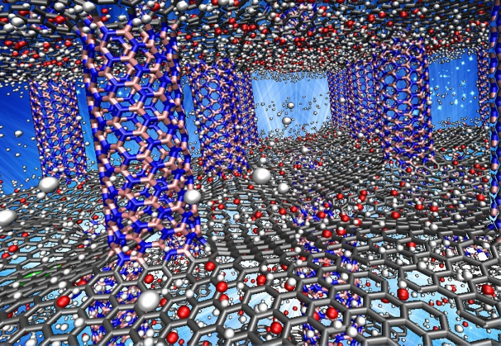
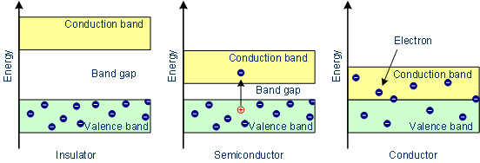
Molecule
Material
Classification of materials

Slide 22
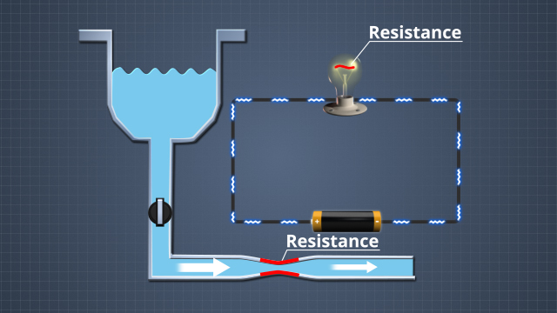
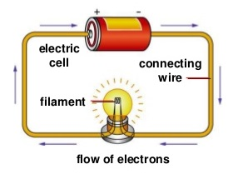

Slide 23
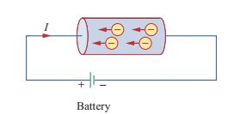
Basic (Definitions, units, ohm’s law, elements and sources)
Charge and Current:
Def: Charge is an electrical property of atomic particles of which matter consists, measured in coulombs (C).
Most basic quantity in electric circuit and it obeys law of conservation of charge.
Def: Electric current is the time rate of change in charge, measured in Amperes (A).
The motion of charge creates electric current and the direction of current is opposite to the electric charge (convention by Benjamin Franklin 1706).
1A = 1 Coulomb/second
A direct current (dc) remains constant with time. (Average value is finite) _ Thomas Edison
An alternating current (ac) varies sinusoidally with time. (Average value is zero for one complete cycle) _ Nikola Tesla

Slide 24
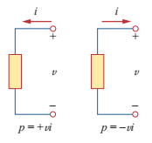
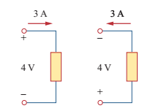
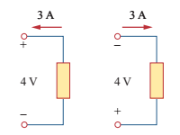
Voltage:
Def: Voltage or potential difference is the energy required move unit charge through an element, measured in volts (V).
1V = 1 joule/coulomb = 1 newton-meter/coulomb
Power:
Def: Power is the time rate of expending or absorbing the energy, measured in watts (W).
Note: Law of conservation of energy must be obeyed in any electric circuit.
Passive sign convention is satisfied when the current enters trough the positive terminal of an element and p=+vi,. If the current enters through the negative terminal, p=-vi.

Slide 25
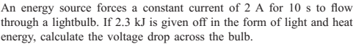
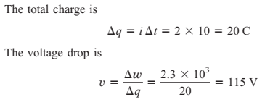
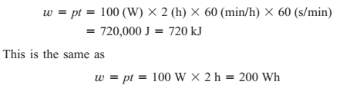
Energy:
Def: Energy is the capacity to do work, measured in joules (J).
Electrical power utility companies measure energy in watt-hours (Wh). Where, 1Wh = 3600 J
Example:1
Example:2

Slide 26
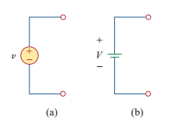
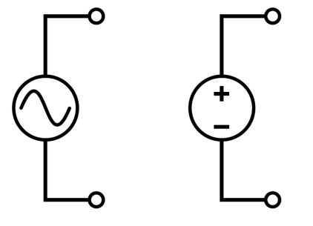
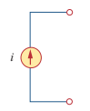
Circuit Elements:
Circuit analysis is the process of determining voltage across the element or current through the element of the circuit.
Active element is capable of generating energy while a passive element is not.
Ex: Generators, and batteries – Active elements
Resistors, Inductors, and capacitors – Passive elements
The most important active elements are voltage or current sources that generally delivers the power to the circuit connected to them. There are two kinds of sources: independent and dependent sources.
Def: An ideal independent source is an active element that provides a specified voltage or current
that is completely independent of other circuit elements.
(a)
(b)
Fig. Symbols of independent voltage sources:
(a) time-varying (ac) voltage, (b) Constant voltage (dc)
Fig. Symbol of independent current source

Slide 27
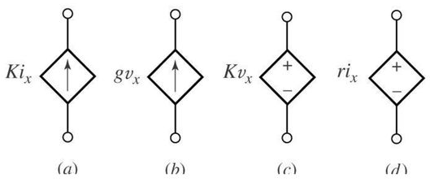
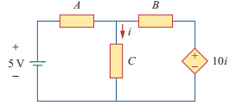
Def: An ideal dependent or controlled source is an active element in which the source quantity
is controlled another voltage or current source.
Dependent sources are usually designated by diamond-shaped symbols, as shown in figure.
Useful for modelling elements such as transistors, amplifiers, and integrated circuits.
Fig. Symbol for dependent sources:
(a) current dependent current source,
(b) voltage dependent current source,
(c) Voltage dependent voltage source,
(d) current dependent voltage source.
What is the type of dependent source?

Slide 28
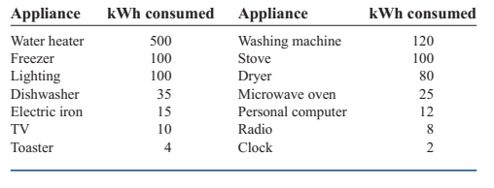
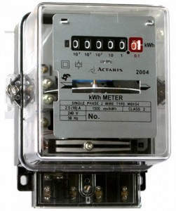
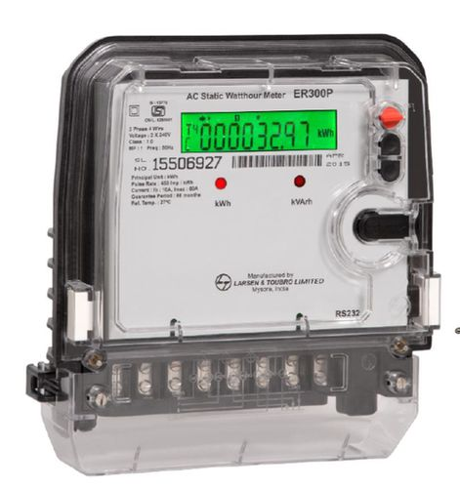
Application
Calculation of electricity bill:

Slide 29
Ex: Problem 3
A house owner consumes 700 kWh January. Determine the electricity bill for the month using the following
Residential rate schedule:
Base monthly charge 50 Rs/service
First 101-200 units : 3.50 Rs/unit
Next 201-500 units: 4.60 Rs/unit
above 500 units: 6.60 Rs/unit
Sol:
Base monthly charge = 50.00
First 200 kWh @3.50 Rs/unit = 3,50.00
Next 300-500 kWh@4.60 Rs/unit= 1,380.00
Over 500 kWh@6.60 Rs/unit = 1,320.00
Total units 700kWh = 3,100.00
Average cost for one unit= 4.42 Rs/kWh

Slide 30
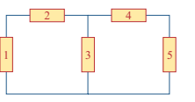
Practice Problems:
1. Referring to the residential rate schedule in Example 2, calculate the average cost per kWh if only
400 kWh are consumed in July when the family is on vacation most of the time.
2. Figure.1 shows a circuit with five elements. If p1=-205W, p2= 45W, p4 = 45W, p5= 30W, calculate the power p3 received or delivered by element 3.
3. Calculate the total cost and cost per kWh for your house referring to the residential rate schedule in
Example 2 (consider previous month current bill).
Fig. 1 (problem. 2)

Slide 31


Ohm’s Law:
Def: Ohm’s law states that the voltage (V) across a resistor is directly proportional to the current (I) flowing through the resistor.
Ω
Fig. (a) Resistor, (b) Symbol
Fig. (a) Variable resistor, (b) Potentio meter
The proportionality constant (R) is the resistance of a material which resists or opposes the flow of current and the unit is ohm (Ω). It is a physical property of a material and can be evaluated in terms of its length (l) and area of cross-section (A). is known as the resistivity of material in ohm-meters.
Resistance: Resistance R of an element denotes its ability to resist the flow of electric current; it is measured in ohm (Ω).

Slide 32



Based on the resistivity, the materials can be further classified into Conductors, semiconductor, and insulators as shown in table.

Slide 33




Note: A non-linear resistor does not obey’s ohm’s law. Its resistance varies with temperature.
Fig. i-v characteristics of a (a) linear resistor, (b) non-linear resistor.
Based on α0 the materials further classified positive temperature (conductors), negative temperature (semiconductors) and zero temperature co-efficient (Manganin is a alloy composed of copper manganese and nickel).
Ro is the resistance at 0°C
α0 is the temperature co-efficient of material.
Copper wire - it will increase by 0.00426 for every 1° rise in temperature
t is the temperature in °C.
Fig. Manganin alloys

Slide 34


R is zero is called short circuit. For short circuit voltage is zero.
R is infinity is called open circuit. For open circuit current is zero.
Conductance:
One more important property in circuit analysis is the reciprocal of resistance known as conductance (G )
Conductance is the ability of an element to conduct electric current; it is measured in mhos () or seimens.
Note:
The power dissipated in the resistor is a non-linear function of either current or voltage when temperature is not constant.
Since R and G are positive quantities, Thus the resistor always absorbs the power from the circuit this confirms the resistor is passive element and incapable of generating energy.

Slide 35



Comparison between Ideal and Practical Sources
Ideal voltage source have zero internal resistance in series with it.
Ideal current source have infinite internal resistance in parallel to it.
But, both are not practically possible to make due to imperfections in the material.

Slide 36


Inductor: Inductor is a passive element which stores the energy in electromagnetic field. If the current allowed to pass through an inductor, it is found that the voltage across inductor is directly proportional to time rate of change in current. Using passive sign convention.
Where L is the constant of proportionality called the Inductance of the inductor measured in Henry (H). One Henry equals 1 volt-seconds per ampere.
Applications: Power supplies, transformers, TV’s, radars and electric motors
Fig. Symbols of an inductor
a) air-core, b) iron-core
c) Variable iron-core.
Note:
We will assume linear inductors unless stated otherwise.

Slide 37

The inductance of an inductor depends on the physical dimension and construction. Formula is derived for calculating the different shapes were discussed in electro-magnetic theory.
Since i(-∞) is zero,
Energy stored in the inductor
N is the number of turns
l is the length
A is the cross-section Area
µ is the permeability of the core.

Slide 38

Properties of an Inductor:
Voltage across the inductor is zero when current is constant.
Thus inductor acts like a short circuit to DC
2) An important property of the inductor is its opposition to the change in the current flowing through it.
The current through the inductor cannot change directly.
3) The ideal inductor does not dissipate energy.
The inductor takes the power from the circuit when stores the energy and delivers power to the circuit when returning previously stored energy.
4) A practical, non-ideal inductor has a significant resistive component,. This is due to the fact that inductor is made conducting material such as copper, which has some resistance.
Circuit model for the
practical inductor

Slide 39


Capacitor: is a passive element designed to store energy in its Electric field.
A capacitor consists of two conducting plates separated by an
insulator (or dielectric). In many practical applications, the
Plates may be aluminium foil while the dielectric may be air,
Ceramic, paper, or mica.
Applications: electronic circuits, communication systems,
Computers, power systems.
A capacitor with applied voltage
When a voltage source V is connected to the capacitor, as in
Fig. The source deposits positive charge q on one plate and the
negative charge –q on the other. The capacitor is said to store
electric charge. The amount of charge stored is directly
proportional to the applied voltage v :
Capacitance is the ratio of the charge on one plate of a capacitor to the voltage difference between the two plates, measured in Farads (F). 1 farad = 1 coulomb/volt.

Slide 40


Circuit symbol for capacitors: (a) fixed capacitor
(b) Variable capacitor
A typical capacitor
The value of the capacitor C depends on the
physical dimensions of the capacitor.
A is the surface of each plate
d is the distance between the plates
ɛ is the permittivity
Typically, capacitors have values in the
Picofarad (pf) to microfarad (µf)
Since v(-∞) is zero,
Energy stored in the capacitor

Slide 41

Properties of Capacitor:
D.C Voltage across a capacitor is not changing with time, the current through the capacitor is zero.
Thus a capacitor acts like a open circuit to DC
However, if a battery (dc voltage) is connected across a capacitor, the capacitor charges
2) The capacitor resists an abrupt change in the voltage across it.
The voltage across the capacitor cannot change directly.
3) The ideal capacitor does not dissipate energy.
The capacitor takes the power from the circuit when stores the energy and delivers power to the circuit when returning previously stored energy.
4) A practical, non-ideal capacitor has a parallel-model leakage resistance. The leakage resistance may be as high as 100MΩ and can be neglected for most practical applications.
Circuit model for the
practical capacitor

Slide 43


Branch, Nodes and loops
Branch (b): A branch represents a single element such as a voltage source or a resistor. In other words, a branch represents a two-terminal element.
Node (n): A node is the point of connection between two or more branches.
mesh (l): A mesh is a closed path in a circuit.
b = m + n -1

Slide 44



Note:
1. If two are more elements are connected in series if they exclusively share a single node and
consequently carry the same current.
2. Two or more elements are in parallel if they are connected to the same two nodes and
consequently have the same voltage across them.
Find the power in each element and also comment on power of each element

Slide 46


Slide 47


Slide 48
Summary
An electric circuit consists of electrical elements connected together.
The international System of units (SI) is the international measurement language, which enables engineers to communicate their results. From six principal units, the units of other physical quantities can be derived.
Current is the rate of charge flow.
Voltage is the energy required to move 1C of charge through an element.
Power is the energy supplied or absorbed per unit time. It is also the product of voltage and current.
According to passive sign convention, power assumes a positive sign when the current enters the positive polarity of the voltage across an element.
An ideal voltage source produces a specific potential difference across its terminals regardless of what is connected to it. An ideal current source produces a specific current through its terminal regardless of what is connected to it.
Voltage and current sources can be dependent or independent. A dependent source is one whose value depends on some other circuit variable.
Two areas of application of the concepts covered in this tutorial electricity billing procedure.

Slide 49
Summary
A resistor is a passive element in which the voltage v across it is directly proportional to the current I through it.
A short circuit is a resistor with zero resistance (R=0). An open circuit is a resistor with infinite of its resistance ( R=infinity)
The conductance G of a resistor is the reciprocal of its resistance
The voltage across an inductor is directly proportional to the time rate change of the current through it. V = L di/dt.
Energy stored in the inductor is (1/2) Li²
The current through a capacitor is directly proportional to the time rate change of the voltage across it. I = C dV/dt.
Energy stored in the inductor is (1/2) LCV²
No.of branches b= l + n -1.
When the elements are in series, the same current flows through them (i1 = i2).
When elements are in parallel, the voltage across them are equal (V1 = V2)
Kirchhoff’s current law (KCL) states that the current at any node algebraically sum to zero. In other wards some of the currents entering a node equals the sum of currents leaving the node.
Kirchhoff’s voltage law (KVL) states that the voltages around a closed path algebraically sum to zero. In other words, the sum of the voltage rises equals to the sum of the voltage drops.

Slide 50
Tutorial - 02
DC circuits with resistance
problems based on KVL and KCL

Slide 51
Series Circuit

Slide 70


Formulas for Inductor
configurations in both series and parallel
Formulas for Capacitor
configurations in both series and parallel

Slide 71


Slide 72


Slide 73


Convert the delta network into equivalent star:

Slide 74


Find the equivalent resistance between A and B
R_{AB} = 2.25Ω

Slide 75
Tutorial - 04
Nodal and Mesh analysis

Slide 76
The method of analysing a circuit is called ‘Mesh analysis’ when Kirchhoff’s voltage law is applied and it is called ‘Nodal analysis’ when Kirchhoff’s current law is applied.
Nodal Analysis:
We interested in finding the node voltages by applying Kirchhoff’s current law:
1. Identify all the independent nodes. The voltages at these nodes are unknown.
2. Select any one of the nodes as reference node. Assign zero potential at this node.
3. Assign potentials at other independent nodes.
4. Apply Kirchhoff’s current law at each node and write the governing equations.
5. Solve for the unknown voltages
Note:
Current flows from a higher potential to lower potential in a resistor.

Slide 77




Using nodal analysis obtain the current flowing through each element.
Substitute I1, I2 and I3 in eq (1)
_
Applying krichhoff’s current law at node B
(1)
V_{B} = 25.56 V
From the circuit I1, I2 and I3 are
Negative current of I1 indicates that the direction of current is from B to A.

Slide 78




Find the voltage across A and B.
Apply Kirchhoff’s law at node B
(3)
Apply Kirchhoff’s law at node A
Simplifying (2) and (3) and solve V_{A} and V_{B}
(2)
V_{A} = 81.1V, V_{B} = 21.7V

Slide 79

Calculate the node voltages in the circuit:
Ans: V1 = 13.33V, V2 = 20V

Slide 80

Practice - Calculate the node voltages in the circuit:
Ans: V1 = -2V, V2 = -14V

Slide 81



Mesh Analysis:
It is only applicable to a circuit that is planar. A planar circuit is one that can be drawn in a plain
with no branches crossing one another; otherwise it is a nonplanar.
We interested in finding the mesh currents by applying Kirchhoff’s voltage law:
1. Assume unknown currents in the given circuit and show their directions arbitrarily
by arrows.
2. Apply KVL, and represent the equation in terms of mesh currents (unknown)
3. Obtain the unknown current by solving the equations.
Planar circuit with crossing branches
circuit with no crossing branches
Non-planar circuit
Note:
A mesh is a loop which does not contain any other loops within it.
K. Sateesh Kumar, Asst.Prof, SRMIST, Kattankulathur

Slide 84

Calculate the mesh currents i1, i2, and i3:
Ans: i1 = 1A, i2 = 1A, i3 = 0A

Slide 85

Practice - Calculate the mesh currents in the circuit:
Ans: i1 = 2A, i2 = 0A

Slide 88




Super Node
If a voltage source exists between two contiguous non-reference nodes, the two non-reference nodes are collapsed into a single node called a Super node, and the voltage source and any elements connected in series with it removed. However, KCL must still be satisfied within a super node using old voltage labels. Also, the removal of the voltage source provides another nodal equation.

Slide 89

Super Mesh
If a current source exists between two contiguous meshes, the two meshes are collapsed into a single mesh called a Super mesh, and the current source and any elements connected in series with it removed. However, KVL must still be satisfied within a super mesh using old current labels. Also, the removal of the current source provides another mesh equation.

Slide 90
Tutorial - 05
Network Theorems
Analyzing circuits with Kirchhoff’s law is a tedious process for a large and complex circuits. To handle the complexity, engineers over the years have developed some theorems to simplify circuit analysis.
Super position
Thevenin’s
Norton’s
Source transformation theorem
Maximum power transfer

Slide 91
Linearity property:
It is the property of an element describing a linear relationship between
cause and effect. The property is a combination of both the homogeneity (scaling)
property and additive property.
Homogeneity: If the input is multiplied by a constant, then the output is also multiplied by the same constant.
Additivity: It requires that the response to a sum of inputs is the sum of the responses to each input applied separately.
We say that resistor is a linear element because the voltage-current relationship satisfies both the homogeneity and additivity properties.

Slide 92
Super position theorem:
The idea of superposition rests on the linearity property.
Statement:
. The superposition principle states that the voltage across (or current through) an element in a linear circuit is the algebraic sum of the voltage across (or current through) that element due to each independent source acting alone.
Steps:
1. Turn off all independent sources except one source. Find the output (voltage or current) due to that active source. This implies that we replace every voltage source by 0V (or short circuit), and every current source by 0A (or open circuit) except any one of the source.
Since, the dependent sources are controlled by circuit variables, we can’t left intact the dependent sources.
2. Repeat step 1 for each of the other independent sources.
3. Find the total contribution by adding algebraically all the contributions due to the independent sources.

Slide 93

Use superposition theorem, find v in the circuit.
Ans: 10V

Slide 94

Use superposition theorem, find v_{o} in the circuit.
Ans: 6V

Slide 101
Tutorial - 06
Network Theorems
Analyzing circuits with Kirchhoff’s law is a tedious process for a large and complex circuits. To handle the complexity, engineers over the years have developed some theorems to simplify circuit analysis.
Thevenin’s
Norton’s
Source transformation
Maximum power transfer

Slide 103

Thevenin’s theorem
Statement: A linear two-terminal circuit can be replaced by an equivalent circuit consisting of a voltage source V_{Th} in series with a resistor R_{Th}, where V_{Th} is the open-circuit voltage at the terminals and R_{Th} is the input or equivalent resistance at the terminals when the independent sources are turned off.
Thevenin’s equivalent circuit

Slide 104
Steps:
1. Open circuit the terminals ‘a’ and ‘b’ by removing the load R_{L} connected to it.
2. Find the voltage across the terminals ‘a’ and ‘b’. i.e., V_{TH}
3. Set independent sources zero (short circuit the independent voltage source and
open circuit the independent current source) and use reduction techniques to find R_{Th.}

Slide 105


4. Draw the Thevenin’s equivalent circuit and find the unknown voltage or current.

Slide 112

Find the thevenin’s equivalent circuit across R_{L}. Then find current though
R_{L} = 6Ω, 16Ω and 36Ω.
Ans: 3A, 1.5A, 0.75A

Slide 113

Practice: Find the values of thevenin’s equivalent circuit between the terminals a and b. Then find the current I
Ans: V_{Th} = 9 V, R_{Th} = 3Ω, I = 2.25A

Slide 114
Tutorial - 07
Network Theorems
Analyzing circuits with Kirchhoff’s law is a tedious process for a large and complex circuits. To handle the complexity, engineers over the years have developed some theorems to simplify circuit analysis.
Norton’s
Source transformation
Maximum power transfer

Slide 116

Norton’s Theorem
Statement:
“A linear two-terminal circuit can be replaced by an equivalent circuit consisting of a current source I_{N} in parallel with a resistor R_{N}, where I_{N} is the short-circuit current through the terminals and R_{N} is the input or equivalent resistance at the terminals when the independent sources are turned off”.
Norton’s equivalent circuit

Slide 117
Steps:
1. Short circuit the terminals ‘a’ and ‘b’ by removing the load R_{L} connected to it.
2. Find the current through the terminals ‘a’ and ‘b’
3. Set independent sources zero (short circuit the independent voltage source and
open circuit the independent current source) and use reduction techniques to find R_{Th.}

Slide 118


4. Draw the Norton’s equivalent circuit and find the unknown voltage or current

Slide 121

Find the Norton equivalent circuit of the circuit across the terminals a-b
Ans: I_{N} = 1A, R_{N} or R_{Th} = 4Ω

Slide 122

Find the Norton equivalent circuit of the circuit across the terminals a-b
Ans: I_{N} = 4.5A, R_{N} or R_{Th} = 3Ω

Slide 123


Source transformation
A source transformation is the process of replacing a voltage source Vs in series with a resistor R by a current source i_{s} in parallel with a resistor R, or vice versa.
The Thevenin and Norton equivalent circuits are related by a source transformation

Slide 125
To prove the maximum power transfer theorem, we differentiate P with respect to R_{L} and set the result equal to zero.

Slide 126



Substitute, R_{L} = R_{Th} and compute for the P_{max}
Maximum power is transferred to the load resistance equals the Thevenin resistance as seen from the load (R_{L}=R_{Th})

Slide 128

Practice: Find the value of RL for which the maximum power transfer in the circuit and also find the maximum power.
Ans: R_{Th} = 9Ω, V_{Th} = 22V, P_{max} = 13.44W

Slide 129
Tutorial - 08
Topics:
Transient analysis
Natural response RL and RC circuits
Forced response of first order RL, RC and RLC circuits

Slide 130
What is transients:
Transients are considered as sudden changes in the state of a circuit or network which are indicated by the switch operation.
Transients are also considered as an argument between the input command to output response as a network changes from previous steady state to next steady state with respect to the state variables (inductor current and capacitor voltage).
Though the transients occur for short duration in time, their impact is huge in determining the entire steady state response and also they give critical design specification values .

Slide 131
Response of the system:
The response of any circuit when a source is present is called as forced response. This response is independent to the nature of passive elements and it can be different for different types of inputs.
2) The response of any circuit without any source is called as natural response. This response is purely depends upon the nature of passive elements and determined by the characteristics equation governing the network. Moreover, this source response is possible, provided the network has initial stored energy .
(inductor stores energy in Electromagnetic form, Capacitor stores energy in electrostatic form)
Complete response of a system = Forced response + Natural response

Slide 132
State variables:
These are the critical parameters that must be observed to determine the transient state solution in any network.
In a Capacitor: voltage across the capacitor is the state variable
In a Inductor: current through the inductor is the state variable
Initial conditions:
These are critical values of voltage across capacitor and current through the inductors from the previous steady state of a network which are specifically indicated as:
t = 0⁻ Instant just before the switch operation (steady state)
t = 0⁺ Instant just after the switch operation (transient state)

Slide 133
Order of the circuit:
The number of energy storage components available in distributed form in any circuit represents its order.
R-L, R-C ---First order network
R-L-C, L-L-R, C-C-R, L-C --- Second order network.
Laplace transforms are considered to analyze the network during the Transient state.
Behaviour of the passive elements in transient state in comparison to steady state:
Element | DC SS | Transient
Resistor | R | R
Inductor | Short circuit | Open circuit
Capacitor | Open circuit | Short circuit

Slide 134
First order circuits:
A circuit that contains only sources, resistors and an inductor is called an RL circuit.
A circuit that contains only sources, resistors and a capacitor is called an RC circuit.
RL and RC circuits are called first-order circuits because their voltages and currents are described by first-order differential equations.
R
R
i
i
v_{s}
–
+
–
+
C
v_{s}
L

Slide 135

The source free RC circuit:
(Vo is the initial voltage across Capacitor at t = 0)

Slide 136


Slide 137


Slide 138


Slide 139


Slide 140


Slide 141


Slide 142


Slide 143


Slide 144


Step response of first order circuit:
Series R-C circuit
V(t) = Vss(t) + Vtr(t)
V(t) = V(∞) + [ V(0) – V(∞) ]
Where :
V(0) – Voltage across capacitor before switch operation
and steady state.
V(∞) – Voltage across capacitor after switch operations
and steady state.
T = RC, time constant
Case 1: Without initial condition:
V(0) = 0
V(t) = Vs [1 - ]
Ic (t) = (Vs / R ) [1 - ]

Slide 145


Case 2: With initial condition:
V(0) = Vs
V(t) = Vs + [ V0 + Vs ]
(b) Series R- L circuit:
I(t) = Iss(t) + Itr(t)
I(t) = I(∞) + [ I(0) – I(∞) ]
Where :
I(0) – Current through inductor before switch operation and steady state.
I(∞) – Current through inductor after switch operations
and steady state.
T = L/R, time constant

Slide 146

Case 1: Without initial condition:
I(0) = 0
I(t) = (Vs/R) [1 - ]
V_{L}(t) = L d/dt (I(t))
= Vs
Case 2: Without initial condition:
I(0) = Io
I(t) = (Vs/R) [Io - Vs/R]

Slide 147
Tutorial - 13
Introduction to Transients
Time constant for RL and RC circuits
Analysis of the natural response
Analysis of the forced response

Slide 148


Transient ?
These are present in the circuit when the circuit is subjected to any change in the input magnitude or change in the circuit elements, provided circuit consists of any energy storage elements.
Inductor does not allow sudden changes of current and it stores the energy in the forms of magnetic field.
Capacitor does not allow sudden change of voltage and it stores energy in the form of electric field.
When circuit having only resistive element, no transients are present in the circuit. Since it allows sudden change in current and voltage.

Slide 149
Natural response ?
The response of any circuit or network without any source is called as natural
response. This response is purely depends on the nature of passive element.
Forced response ?
The response of any circuit or network when source is present is called as forced response This response is purely depends on the type input signal.
Complete response of the system = Forced response + Natural response

Slide 150
Initial conditions:
These are the critical value of voltage across capacitor and current through the
inductor from the previous steady state of a network which are specifically
indicated as:
t = 0 ⁻ = instant just before switch operation
(steady state before switch operation)
t = 0 ⁺ = instant just the switch operation
(transient state operation)
t = ∞ = steady state after switch operation
Order of the circuit or network:
The number of energy storage components available in distributed form in any
circuit represents its order.
RL, RC first order RLC, LLR, CCR, LC – second order

Slide 151




Natural response of the first order circuit
The Source-Free RC Circuit
$${I_{R}=−I}_{c}$$
$${I_{c}+I}_{R}=0$$
$$\left(D+\frac{1}{RC}\right)v=0$$

Slide 152


The Source-Free RC Circuit

Slide 153

The time constant of a circuit is the time required for the response to decay to 36.8 percent of its initial value (1/e) or (e⁻¹)
Or It is also defined as time taken by the response to reach 63.4 % to its final value.

Slide 154



The Source-Free RL Circuit
$${v_{R}=−v}_{L}$$
$$\left(D+\frac{R}{L}\right)i=0$$
$$i\left(t\right)=Ae^{−Rt/L}$$

Slide 155

$$I_{o}e^{−Rτ/L}=I_{o}e^{−1}=0.368I_{o}$$

Slide 156

Forced response of first order circuit
Series RC circuit
V(t) = Vss (t) + Vtr (t)
V(t) = V (∞) + [V (0) – V (∞)]
V (0) – voltage across capacitor before switch operation
switch operation and steady state
V (∞) – voltage across capacitor after switch operation
and steady state
T = RC – Time constant

Slide 157


Case 1: Without initial voltage
V (0) = 0
V (t) = Vs [1 - ]
i_{c} (t) = C (dV / dt)
= (Vs/R)
Case 1: With initial voltage
V (0) = Vo
V (t) = Vs + [ Vo - Vs ]

Slide 158

Series RL circuit
i(t) = iss (t) + itr (t)
i(t) = i (∞) + [i (0) – i (∞)]
i (0) – current through the inductor before
switch operation and steady state
i (∞) – current through the inductor after
switch operation and steady state
T = L / R – Time constant

Slide 159

Case 1: Without initial current
I (0) = 0
I (t) = (Vs / R )[1 - ]
V_{L} (t) = L (d I(t) / dt)
= (Vs)
Case 1: Without initial current
I (0) = Io
I (t) = (Vs / R )[ Io - (Vs / R )]

Slide 160








The Source-Free series RLC Circuit
Differentiating the above equation

Slide 161






Slide 162



Roots are negative real and unequal
Roots are negative real and equal
Roots are complex conjugate with negative real

Slide 163




Slide 164


Slide 165


Slide 166








The Source-Free parallel RLC Circuit
Differentiating the above equation

Slide 167



The step response of series RLC circuit

Slide 168





Slide 169



The step response of parallel RLC circuit

Slide 170



i_{ss} (t) = Is

